Slide 1

EASY TRAVEL WEBSITE
IS221 – TECH_FREAK
GROUP MEMBERS
NAME | ID
Shiva Mani Gounder | S11208749
Anshika Rao | S11208306
Shainesh Nand | S11208989
Kolinio Cagi | s11125880

Slide 2
Introduction
Easy Travel –
A travel agency which offers variety of service of travels to individual, people, groups, and organizations
This is including booking, lodging, activities, and transportation
The service can be modified to suit and meet a range of the client's requirements. This is for individual travel, family/vacation travel, or adventure tours.
Mission
Make travel easier for anyone and to our customer who find it hard to travel to and fro

Slide 3
Content Goal
Note
Content Goal explained
This is an e-commerce website, provides user the ability to make business online which reserve and provides travel-linked services
The website is a platform that was designed, to make it easier and provide efficient services to do research which users or customer reserve when they make travel arrangement.
Inspire travel – showcase the beauty and excitement of travel destination
Customer Trust – the website is build to be our customer focus, thus established a trust between our customer which is friendly user, and enables them to trust our services
Provide Destination Information - have a travel guide that has everything our customer needs and shows cultural experiences
Provide accurate and reliable information about the various destination
Encourage Social Engagement – user will be able to access the site freely without hesitation and worry
Create awareness and encourage social engagement that will increase the brand to gain competitive advantage

Slide 4
Audience
Target audience
Some of the examples are as follows:
Anyone who engaged or interact with technology and modernized range of age group from 25-45 years.
Anyone who loves or take pleasure in travelling and exploring new destination.
This target audience are international like America, New Zealand, Australia and locally within the country
Leisure travels – individuals which travel alone just for a trip including family's trip, honeymoon couples etc…
Business travel – people who travels for business internationally and locally
Groups travel – this are those who travel with groups on school trips, sports, and religious group
International travelers – individuals who travels to another country
Within the Budget- user able to find destination and places according to their budget

Slide 5
Site Content & Functional Requirements
Site Content
Functional Requirements
Home Page - - this is the first page when visitors and user first click into the website. It is very appealing and easier interface for user. It provides a brief overview of the agency services and facilities available for user.
About Us – this page contains information about the company agency. It gives details about the service delivered by this website.
Destinations – this page contains all the information's details about each places or destination where visitors or user are travelling to with relevant picture of destinations. It has subtitles where user client can click to that links and view the exact locations. It also provide maps indicating the exact place where visitors are planning to go or travel through mode of transportation.
Contact US – this page indicate the details information of the Phone contacts, Email and address of Travel Agency
Search Function – this is a quick way where user easily search or look for when finding desirable travel places or destination, and what the agent services about, rather than scrolling or clicking on to next page.
Booking Function - this button allows the user to book or reserve travelling packages from the website. In addition it also allows user to view option by choosing method of payment ad destination.
Contact Form – This page functionality is to allow user to get direct contact for queries, and for more relevant information
Book Form – this function is in form view when are click into, where users or visitors are able to book their details information

Slide 6
Site Structure
The structure of the site is well organized which is accessible towards users to navigate and find the desire content they need.
Structured are hierarchical concept with the home page being the main portal.
The Home page will provide links that directs to the various section of the website.
The primary section under it will be the destination, contact and about us.

Slide 7
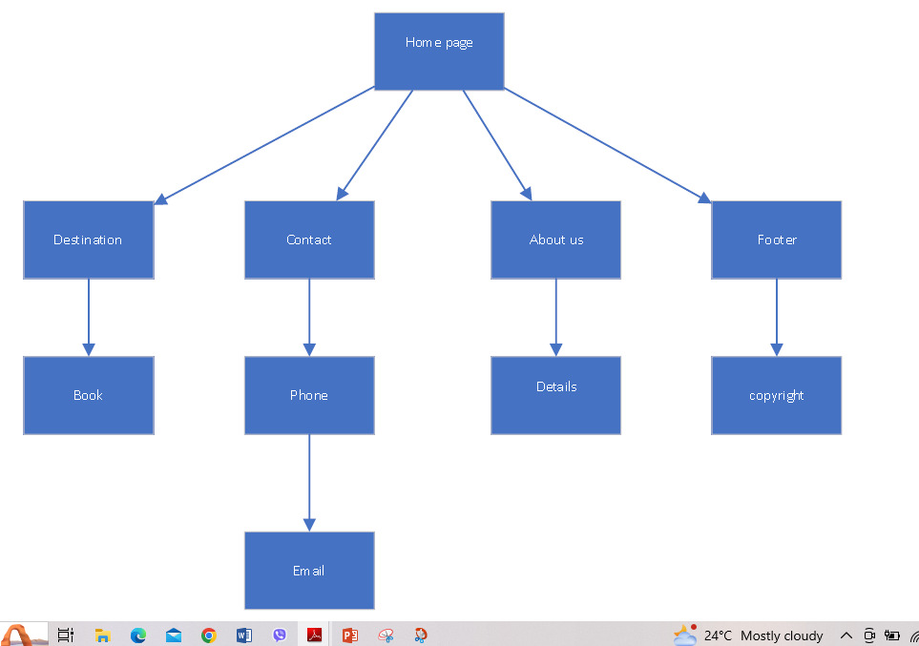
HIERARCHICAL STRUCTURE OF EASY TRAVEL WEBSITE

Slide 8
SITE NAVIGATION
Our website will have a simple and clear navigation for user usage, that answer the following in terms of a user’s perspective:
Where am I? – the user will have a fair idea of the current page his on and has option on the navigation.
Where can I go? – here the navigation menu has option for the user for the categories of Home, Destination, Contact, and About Us.
How do I get there? – Users can select the desired option of category and find their travelling desires and services.
How do I get back to where I started? – the user can select or click on the home option in the navigation menu and return to the top of the home page.
Next is the listed of the navigational menu option that have been implemented in the content structure in the travel agency website

Slide 9
SITE NAVIGATION
Home - This is the page that has been developed with a user-friendly layout and appealing visuals for the users. It is the core of the website for navigation.
Destination - This is the section where users can select and come to the location options available for traveling. Booking and pricing are under the destination section so the user can utilize the destination navigation for the arrangement of travel services.
Contact - This navigation option has the contact details portrayed for users, and thus also has social media platform links to be contacted from.
About us - by clicking on it, the user can access the contact information available on the website for customers in relation to queries and questions.

Slide 10
LAYOUT
NOTE
For a successful online presence, the layout of a website plays an essential or vital part.
A well-structured and designed website should portray a polite and a user-friendly environment towards the users.
Every aspect of the design that has been made, from the header till the footer of the website, has been carefully studied and considered to make sure the content desired by the user is found easily for them and make booking for travelling.
The website (Easy Travel) acts as a virtual portal in the modern /digital era, making it possible to be one stop shop for travelers need.
Easy Travel has an appealing gradient line background color that is catchy and comfortable in terms of the user’s sight.
A horizontal navigation bar has been constructed in the layout to have easier navigation for customers to locate contents. To ensure a smooth layer and visual of the website Headers, Sections, classes, heading and footer have been used in the layout.
Active whitespace has been used to guide the user’s eyes towards the important contents on the website, providing space or gap between each section, thus making layout of the website more balanced.
It makes the reading of content more visible making the information easier to be digested.
Through the use active whitespace, designers can efficiently create an appealing layout, which over roll improves the effectiveness of the website.

Slide 11
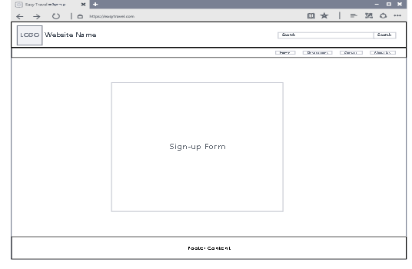
LOGIN/SIGN UP

Slide 12
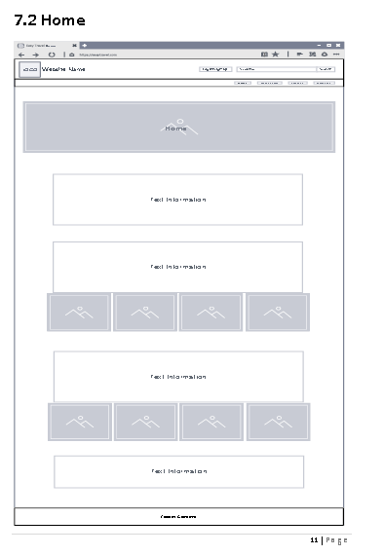
HOME

Slide 13
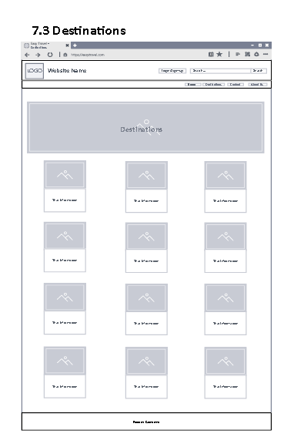
DESTINATIONS

Slide 14
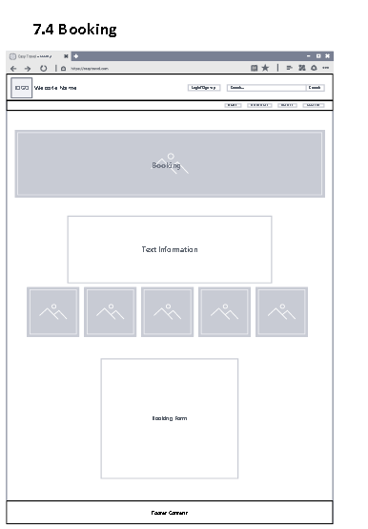
BOOKINGS

Slide 15
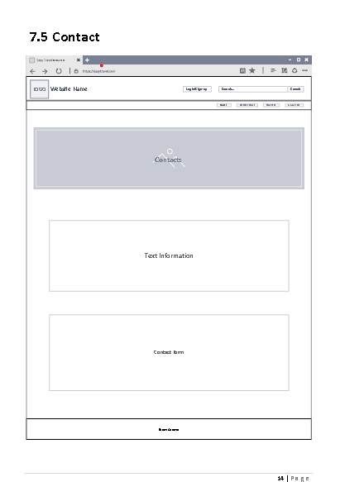
CONTACT

Slide 16
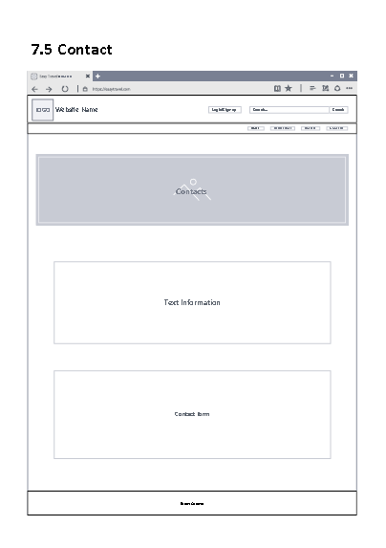
ABOUT US

Slide 17
ACCESSIBILITY
The webpage has been developed with a user-friendly layout and appealing visuals for the user’s ease.
The major focus of the website was implemented into the website’s accessibility for users as the website allows the users to access the site on various platform, that includes phones, and laptops.
Visual appearance is taken into consideration of appropriate fonts, and contrast, with appealing images and clear navigation, these all are specifically done for the user’s ease and proper navigation that the user finds comfortable for his /her usage.
Many users become anxious and uninterested when searching for desired content from heaps of information and tabs available on a website, thus our Easy Travel websites have main content of information portrayed on the main/ home page of the website such as home, destination, contact, and about us. This gives the desired information at once without multiple directions to be taken.

Slide 18
DOMAIN NAME REGISTRATION
EXPLAIN
Firstly, let us go over the domain name, a domain name is simply the name of your website with a unique, simple address to access the site such as “google .com” and “mkvhub.com”. DNS system helps users to easily connect to different websi
Based on the research we carried out on domain name and hosting costs for our travel agency website (Easy Travel), we have found that domain name registration in Fiji is pretty straightforward and has an estimated cost of range in FJD 100 for one year, which relies on the domain extension being used in the website.

Slide 19

DOMAIN NAME REGISTRATION
Given below are the process of registering a domain name:
Check availability- this is the first step taken to check whether the domain name we have selected for domain name is available. You can check by visiting on domain registry service and search in search box.
Choose register- when you have selected the domain name available, then you ll need to choose a register to register the domain name together.
Provide details: here, you’ll have to give the personal details as phone contact and the wanted domain name, them do the transaction for registration

Slide 20
HOSTING COSTS
Looking over hosting website, once the domain name registration is completed, then you’ll require a host to website.
There are various hosting providers and cost varies on the type of host plan and service needed.

Slide 21

HOSTING COSTS
Given blow are the average cost that hosting a website takes in Fiji:
Shared host- her is the most budget type of hosting that allows the sharing of resources from server with other variant websites. Hosting cost ranges from USD2.99.
VPS hosting: here, you can have a virtual server for your website, but other websites will require a physical sever. Around USD39.99per month for VPS hosting.
Dedicated hosting -this is the most expensive hosting which requires a physical sever for the website. Dedicated hosting takes USD159.99.
In summation, registration of domain in Fiji is simple and straightly to point of FJD 100 per year however hosting a website can be costly as it ranges from USD 2.99-159.99 per month depending on type of service need and type of hosting.

Slide 22
Layout of the website

Slide 23



Testing
The website was tested in different browsers and the results were:
Chrome - this browser works the bests with our site
Edge – this browser doesn’t properly with our browser the area that doesn’t seems work properly CSS
Avast – the test result was similar to edge

Slide 24


Promotional Video Link
https://youtu.be/Y37N3rLTbYA

Slide 25

ANY QUESTION?

